Slide 1



CHEMISTRY: FROM ORE TO METAL: EXPLORING THE JOURNEY OF METALS
Class 10 art integration project on chemistry

Slide 2

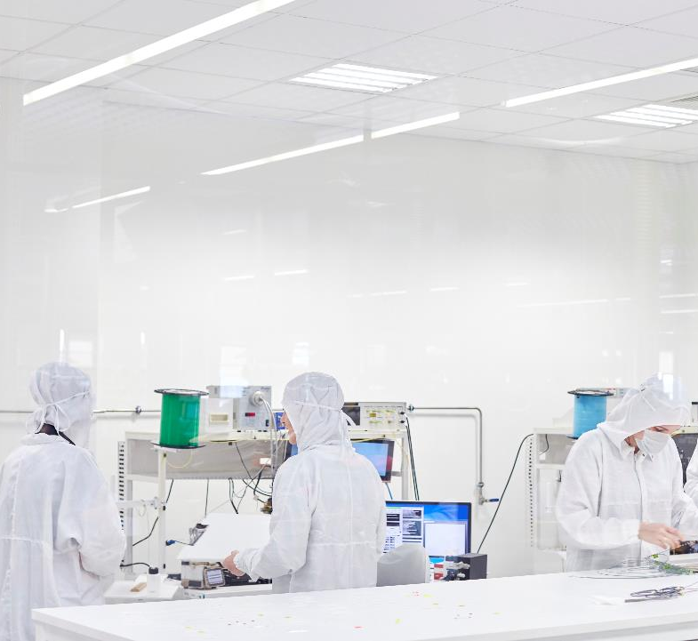
Steps involved:
BENIFICIATION
EXTRACTION
PURIFICATION

Slide 3
TWO COMMON MINERALS: GYPSUM & LIMESTONE
Gypsum:
•A soft mineral composed of calcium sulfate dihydrate (CaSO₄·2H₂O).
•Forms from the evaporation of water in marine and saline environments.
•Used in plaster of Paris, drywall, and soil conditioning.
•Found mainly in sedimentary rock formations.
•Significant deposits in Karnataka and Ladakh.
________________________________________
Limestone:
•A sedimentary rock primarily made of calcium carbonate (CaCO₃).
•Forms from the remains of marine organisms or through evaporation.
•Essential for cement production, construction, and agriculture.
•Used in lime production and as a building material.
•Found in Karnataka and Ladakh

Slide 4
Gypsum: Physical Properties, Chemical Properties, and Extraction Process
Gypsum is a naturally occurring mineral composed of calcium sulfate dihydrate with the chemical formula CaSO₄·2H₂O. It is widely used in construction, agriculture, and various industries due to its versatility and abundance.
________________________________________
Physical Properties of Gypsum
1. Appearance: Gypsum is usually white, colorless, or gray but can also appear in shades of pink, yellow, or brown due to impurities.
2. Crystal System: Monoclinic.
3. Hardness: Very soft mineral with a Mohs hardness of 2.
4. Luster: Vitreous to silky or pearly.
5. Cleavage: Perfect in one direction.
6. Specific Gravity: Approximately 2.3.
7. Solubility: Slightly soluble in water; more soluble in warm water.
8. Transparency: Transparent to translucent.
9. Forms: Commonly found in massive, granular, fibrous, or crystalline forms such as selenite, alabaster, and satin spar.
________________________________________
Chemical Properties of Gypsum
1. Chemical Formula: CaSO₄·2H₂O (Calcium sulfate dihydrate)
2. Composition:
o Calcium (Ca) – 23.3%
o Sulfur (S) – 18.6%
o Oxygen (O) – 53.8%
o Water (H₂O) – 20.9%

Slide 5
3. Reactivity:
o When heated to about 150°C, gypsum loses water and forms Plaster of Paris (CaSO₄·½H₂O).
o Rehydration of Plaster of Paris returns it to its original form (gypsum), making it ideal for casting and molding.
o Gypsum is non-toxic and chemically stable under normal environmental conditions.
-----------------------------------------------------------------------------------------------------------------------------------------
Extraction Process of Gypsum
Gypsum is primarily obtained through open-pit mining. The process involves the following steps:
1. Exploration and Site Preparation:
o Geological surveys locate gypsum deposits.
o Once a site is selected, overburden (topsoil and rock) is removed to expose the gypsum.
2. Drilling and Blasting:
o In larger mines, controlled blasting may be used to break up the rock.
o In smaller deposits or where high purity is required, mechanical methods are preferred.
3. Mining:
o Excavators, bulldozers, and front-end loaders remove the gypsum rock.
o It is transported to a processing facility for crushing and sizing.
4. Crushing and Screening:
o The mined gypsum is crushed into smaller pieces.
o It is screened to produce uniform particle sizes for further processing.
5. Calcination (if needed):
o For making products like Plaster of Paris or wallboard, gypsum is heated in kilns to remove water (calcination), forming calcium sulfate hemihydrate.

Slide 6
o Equation:
CaSO₄·2H₂O → CaSO₄·½H₂O + 1.5H₂O (heat)
6. Packaging and Transport:
o The final product (raw gypsum or calcined gypsum) is packaged and transported for industrial, construction, or agricultural use.
________________________________________
Applications of Gypsum
• Construction: Drywall, plaster, cement additive.
• Agriculture: Soil conditioner to improve aeration and reduce soil compaction.
• Medical: Orthopedic casts (Plaster of Paris).
• Art and Decoration: Sculpting material (alabaster).
________________________________________
Gypsum is a low-cost, sustainable, and essential mineral with wide-ranging applications due to its unique properties and ease of processing.

Slide 7
STATISTICAL ZONE
AT THE GRAPH…..

Slide 8
Limestone: Physical Properties, Chemical Properties, and Extraction Process
Limestone is a sedimentary rock primarily composed of calcium carbonate (CaCO₃), and it is one of the most abundant and versatile rocks on Earth. It forms in a variety of geological settings, from shallow marine environments to caves. It is used in a wide range of applications, including in the construction industry, agriculture, and various industrial processes.
________________________________________
Physical Properties of Limestone
1. Appearance: Limestone typically appears as a light-colored rock, ranging from white to gray, but it can also be yellow, brown, or pink depending on impurities like clay, sand, or iron oxide.
2. Hardness: Limestone has a moderate hardness, typically 3 to 4 on the Mohs scale.
3. Texture: It can have a granular texture when composed of fine-grained calcite or a more coarse texture when composed of larger crystals.
4. Porosity: It is often porous, which makes it useful in water filtration and as a reservoir rock in oil and gas deposits.
5. Density: Limestone has a specific gravity between 2.3 to 2.7, which is typical for most sedimentary rocks.
6. Cleavage: While it doesn’t have perfect cleavage, limestone may break along irregular fractures.
7. Reactivity: When exposed to acids, limestone reacts and fizzes due to the release of carbon dioxide (CO₂).
________________________________________
Chemical Properties of Limestone
1. Chemical Formula: The primary component of limestone is calcium carbonate (CaCO₃).

Slide 9
2. Composition:
o Calcium (Ca) – 40%
o Carbon (C) – 12%
o Oxygen (O) – 48%
3. Reactivity:
o Acid Reaction: When limestone comes in contact with hydrochloric acid (HCl), it reacts to form calcium chloride (CaCl₂), water (H₂O), and carbon dioxide (CO₂) gas.
▪ CaCO₃ + 2HCl → CaCl₂ + H₂O + CO₂
o This characteristic is useful in carbon capture processes and in the liming of soils.
________________________________________
Extraction Process of Limestone
Limestone is extracted through quarrying or mining. The extraction process typically involves the following steps:
1. Exploration and Site Preparation:
o Geological surveys are conducted to locate suitable limestone deposits.
o Once a site is identified, it is prepared by removing overburden (soil and rock layers covering the limestone).
2. Drilling and Blasting:
o In large-scale quarries, controlled blasting is used to break up the limestone into manageable pieces.
o For smaller deposits, mechanical excavation using bulldozers or excavators may be employed.
3. Extraction:
o After blasting, the limestone is hauled to a processing facility for further processing. In large quarries, loaders and haul trucks are used to transport the rock.

Slide 10
4. Crushing and Screening:
o The extracted limestone is crushed into different sizes and shapes according to the intended use (e.g., coarse for construction or fine for cement production).
o The material is then screened to remove impurities and ensure uniformity in particle size.
5. Calcination (if needed):
o Calcination is the heating of limestone to produce quicklime (CaO) and carbon dioxide (CO₂).
▪ CaCO₃ → CaO + CO₂ (heat)
6. Storage and Transport:
o The processed limestone is stored in large silos or piles before being transported to various industries, such as cement factories or steel plants.
________________________________________
Applications of Limestone
1. Cement Production: The primary use of limestone is in the production of cement. It is heated in a kiln to produce quicklime (CaO) and carbon dioxide. The lime is then mixed with other materials to form Portland cement.
2. Construction: Limestone is used as a building material due to its durability. It is also used in road construction, asphalt production, and ballast in railroads.
3. Agriculture: Ground limestone (also called aglime) is used to neutralize acidic soils and improve soil quality.
4. Steel Production: In the steel industry, limestone is used as a flux to remove impurities from molten iron in the blast furnace.
5. Water Treatment: Limestone is used in water filtration systems, helping to remove impurities and raise the pH level of water.
6. Carbon Capture: In flue gas desulfurization, limestone is used to remove sulfur dioxide (SO₂) from power plant emissions, helping to reduce air pollution.

Slide 11
Conclusion
Limestone is a vital resource found in many parts of the world, including regions like Karnataka and Ladakh. Its versatile applications in construction, agriculture, and industry make it an essential mineral. The extraction process, while varying in scale, generally follows similar steps: from quarrying and crushing to its use in cement, steel production, and other industrial processes.

Slide 12
STATISTICAL ZONE
AT THE GRAPH…

Slide 13


THANK YOU
~VIKRANT CHAKRADHAR
MAJETI , X - A

